Slide 1

StaRtistics introduction to statistics

Slide 2
Statistics aim to understand your data by describing it and making predictions

Slide 3
Descriptive statistics

Slide 4
Descriptive stats aims to describe data’s distribution by central tendency (location in a plane) and dispersion (spread) around the location

Slide 5
Useful descriptive stats and associated functions

Slide 6
Central tendency
Mean : the arithmetic average
Median: the middle value of array
Mode: Most common value of array

Slide 7
Data spread
Max : the arithmetic average
Min: the middle value of array
Find k largest/ smallest elements

Slide 8
Data spread
Standard deviation : the arithmetic average
Variance: the middle value of array
Range: elements

Slide 9
Dealing with missing data
Standard deviation : the arithmetic average
Variance: the middle value of array
Range: elements

Slide 10
Dealing with outliers
Standard deviation : the arithmetic average
Variance: the middle value of array
Range: elements

Slide 11
Confidence Intervals
Not only do you want to DESCRIBE the general tendency of your data but also the SPREAD...

Slide 12
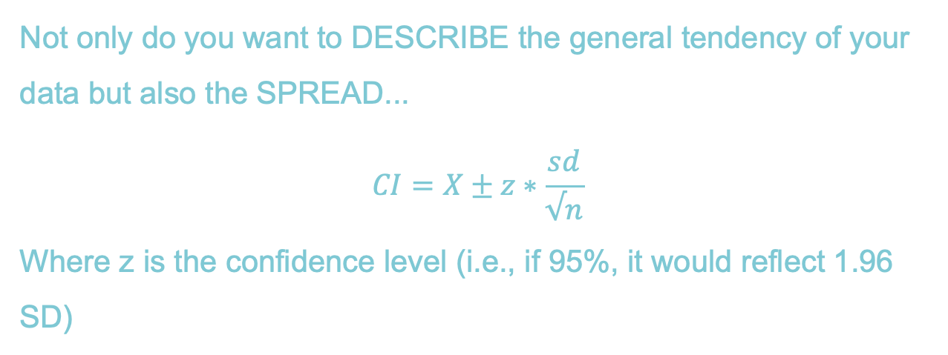
Confidence Intervals
Not only do you want to DESCRIBE the general tendency of your data but also the SPREAD...
$$CI=X±z∗\frac{sd}{√n}$$
Where z is the confidence level (i.e., if 95%, it would reflect 1.96 SD)

Slide 13
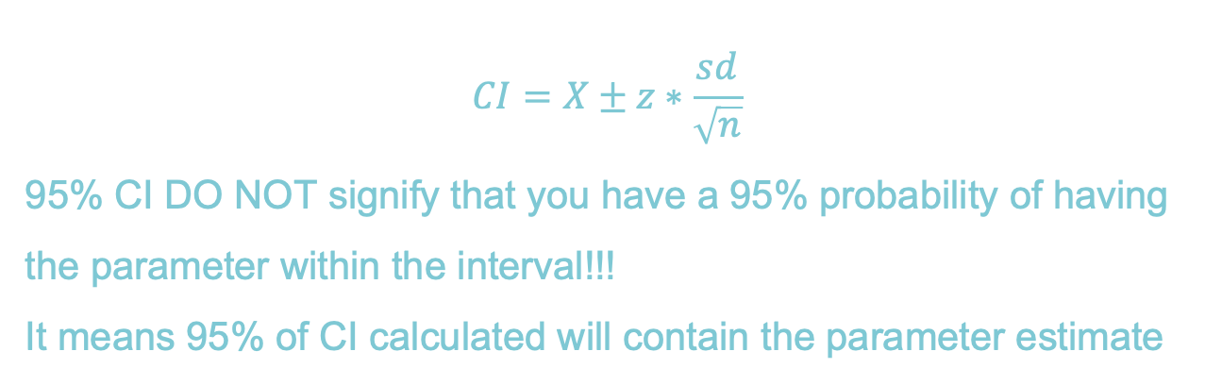
Confidence Intervals
$$CI=X±z∗\frac{sd}{\sqrt{n}}$$
95% CI DO NOT signify that you have a 95% probability of having the parameter within the interval!!!
It means 95% of CI calculated will contain the parameter estimate

Slide 14
Correlation
Correlations is the relationship between any two variables
They can be described in different ways:
Pearson—linear relationship between continuous variables
Spearman Rho—nonparametric rank correlation, describing two variables as a monotonic function

Slide 15
Correlation
Correlations is the relationship between any two variables
They can be described in different ways:
Pearson—linear relationship between continuous variables
Spearman Rho—nonparametric rank correlation, describing two variables as a monotonic function INSERT FUNCTION AND OUTPUTS HERE

Slide 16
Inferential statistics

Slide 17
Inferential stats aims to predict future outcomes or observations based on your data

Slide 18
Most popular programs

Slide 19
T-test
Student t-test allows you to test mean differences between normal distributions
There are many different flavours of t’s
one-sample vs two samples
paired vs unpaired
one tail vs two

Slide 20
T-test
T-tests assume that your data come from a normal distribution and the observations are sampled independently from one another
These assumptions apply for both paired and unpaired test

Slide 21
T-test
One-sample t-tests test the hypothesis that mean is different than a prespecified u0
Independent-sample t-tests test the hypothesis that the mean difference between both samples is not 0

Slide 22
T-test
Paired t-tests are used when the observations are repeated, i.e., each person is sampled twice thus each observation comes in a pair
Unpaired t-tests are used when the observations are independent

Slide 23
T-test
One tail tests are used when you have directional hypotheses (i.e., group A is bigger than group B)
Two tail tests are used when you have non-directional hypotheses (i.e., group A is different than group B, but you don’t care if it’s bigger or smaller)

Slide 24
T-test
EXPLAIN THE FUNCTIONS

Slide 25
T-test
Given the same number of data which type of t-test is more stringent? Which one requires a bigger mean diff for the same value of t?

Slide 26
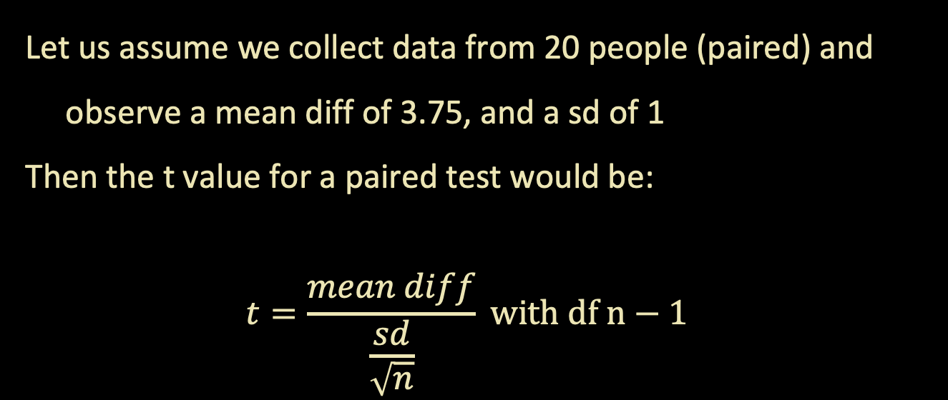
T-test
Let us assume we collect data from 20 people (paired) and observe a mean diff of 3.75, and a sd of 1
Then the t value for a paired test would be:
$$t=\frac{mean diff}{\frac{sd}{\sqrt{n}}} with df n−1$$

Slide 27
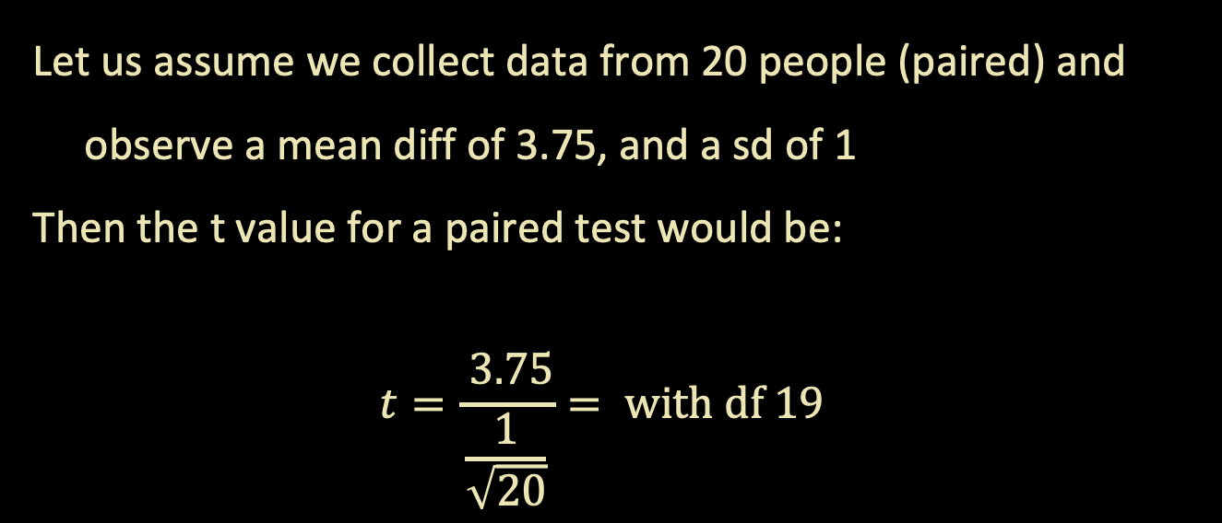
T-test
Let us assume we collect data from 20 people (paired) and observe a mean diff of 3.75, and a sd of 1
Then the t value for a paired test would be:
$$t=\frac{ 3.75}{\frac{1}{\sqrt{20}}}= with df 19$$

Slide 28
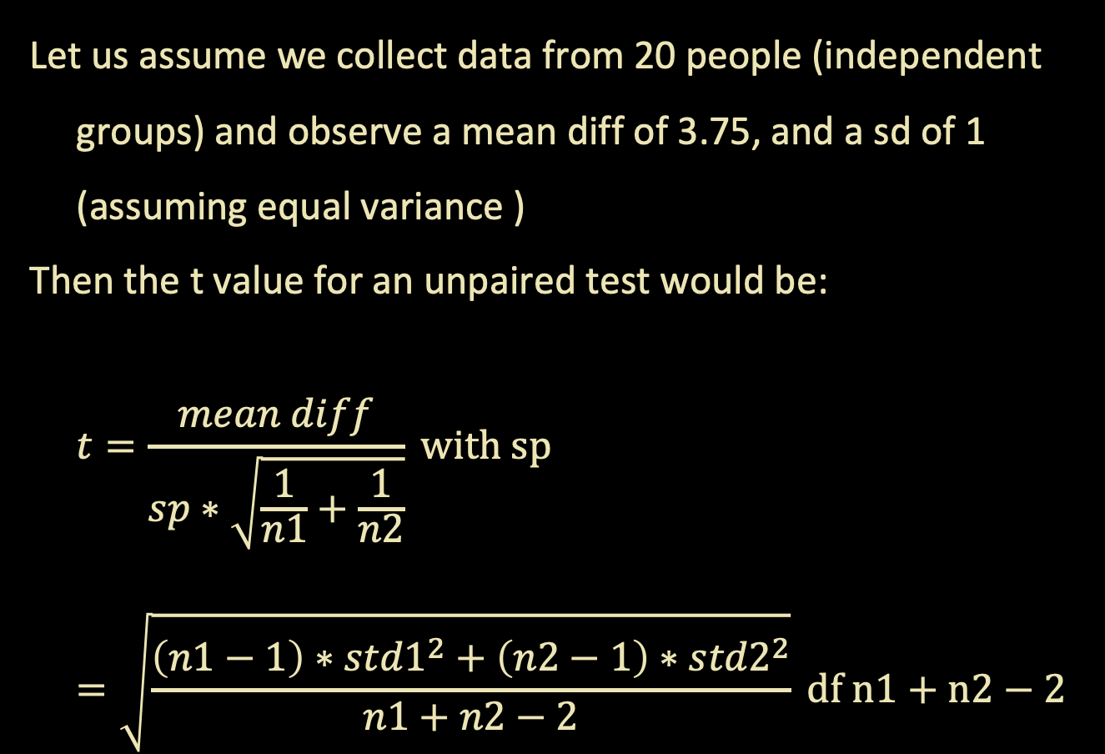
T-test
Let us assume we collect data from 20 people (independent groups) and observe a mean diff of 3.75, and a sd of 1 (assuming equal variance )
Then the t value for an unpaired test would be:
$$t=\frac{mean diff}{sp∗\sqrt{\frac{1}{n1}+\frac{1}{n2}}} with sp=\sqrt{\frac{\left(n1−1\right)∗{std1}^{2}+\left(n2−1\right)∗{std2}^{2}}{n1+n2−2}} df n1+n2−2$$

Slide 29
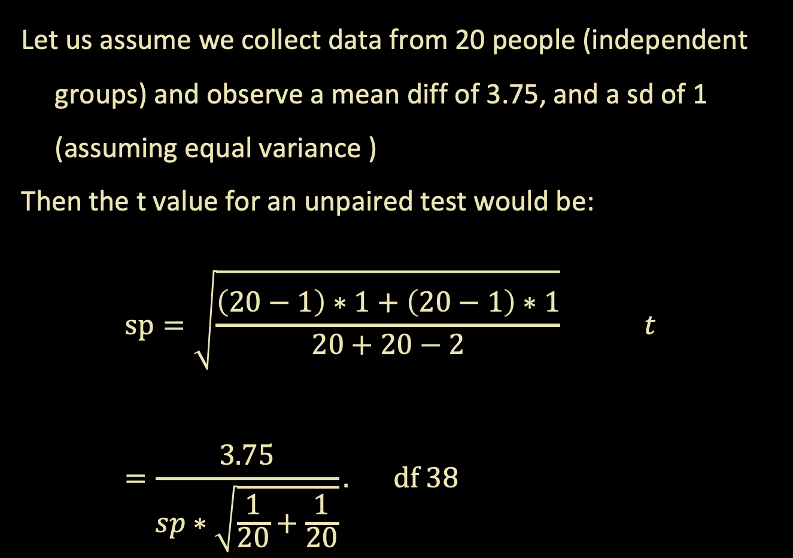
T-test
Let us assume we collect data from 20 people (independent groups) and observe a mean diff of 3.75, and a sd of 1 (assuming equal variance )
Then the t value for an unpaired test would be:
$$sp=\sqrt{\frac{\left(20−1\right)∗1+\left(20−1\right)∗1}{20+20−2}} t=\frac{3.75}{sp∗\sqrt{\frac{1}{20}+\frac{1}{20}}}. df 38$$

Slide 30
T-test
T value for paired is larger, in comparison to t values of unpaired or independent tests
This is because within-person designs have more power as they control for more noise by observing the same person twice

Slide 31
(non) Paramaetric

Slide 32
Non-parametric tests
In stats there are some tests that are non-parametric, by this statisticians mean that the test does not require assuming a specific model or distribution for your data
These are sometimes referred to as non-distributional tests
These tests are used when you do not want to assume a specific distribution (e.g., violation), or do not know the distribution of your data

Slide 33
Non-parametric t-tests
Regular t-tests assume your data is normally distributed
There is a non-parametric equivalent of a t-test called the permutation t-test. This test works on the premise that you can observe a null distribution from your own data by randomly permuting groups.
Reminder: a null distribution is the distribution when the null hypothesis is true

Slide 34
permutations
Group A Group B
Permutations build a null distribution of data based on your observations under the assumption that randomly shuffling your data will void the effect of interest. Thus, you can measure how surprising the effect you observe is given your data based on the computed null distribution
A
B
Permute data
A
B

Slide 35
permutations
Group A Group B
This technique is very similar to bootstrapping without replacement (i.e., no duplicate observations).
A
B
Permute data
A
B

Slide 36
permutations
Group A Group B
A
B
Permute data
A
B

Slide 37
Bootstrapping
A very similar concept in statistics is the idea of bootstrapping to get a measure of uncertainty around an estimate (e.g., CI)
Bootstrapping is like permutations in that they resample your data, however bootstrapping requires replacement
It is often used to calculate the error associated to an estimate, effect, or performance of an algorithm and allows you to know if one given data point is driving the effect you see

Slide 38
Bootstrapping
Bootstrapping is like permutations in that they resample your data, however bootstrapping requires replacement
A
B1
B2
B3
Avg _{obs}
Avg _{b1}
Avg _{b2}
Avg _{b3}

Slide 39
Bootstrapping
The computed Avg for each bootstrap will allow you to get an idea of what range of values you could expect given your data
A
B1
B2
B3
Avg _{obs}
Avg _{b1}
Avg _{b2}
Avg _{b3}

Slide 40
Analysis of Variance

Slide 41
ANOVA
Analysis of Variance is a linear model to test if there is a difference between two or more means (i.e., groups sometimes called levels)
Let us start with a one-way ANOVA

Slide 42
ANOVA
One-way ANOVA (i.e., one FACTOR)
Test the difference between groups (levels). It answers the question:
Are the group means spread out much more than what you’d expect if you had sampled all the groups from the same distribution?

Slide 43
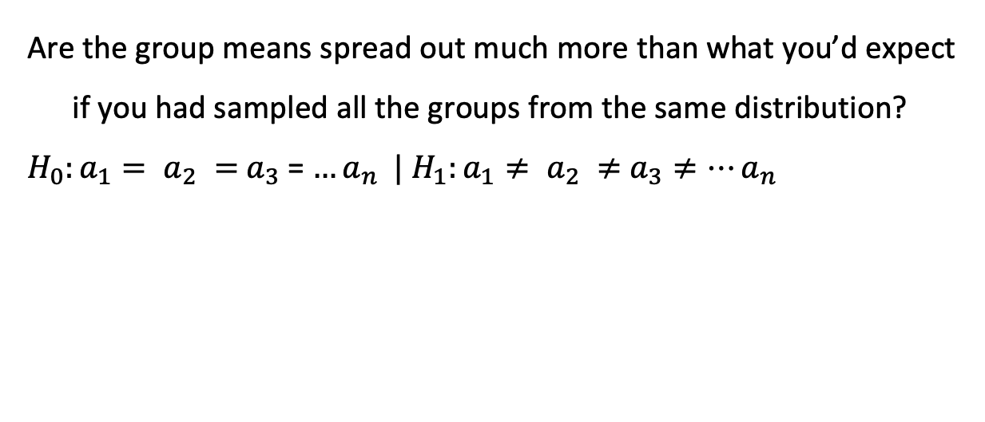
ANOVA
Are the group means spread out much more than what you’d expect if you had sampled all the groups from the same distribution?
$H_{0}:a_{1}= a_{2} =$ $a_{3}$= $…a_{n} |$ $H_{1}:a_{1}≠ a_{2} ≠$ $a_{3}≠…a_{n}$

Slide 44
ANOVA
Assumptions of a One-way ANOVA:
Normality of data
Homogeneity of variances (all variances are born equal)
Independent samples

Slide 45
ANOVA
Normality of data
Can test this by visualizing your data / residuals (see regression) or by a Shapiro-Wilk test

Slide 46
ANOVA
Homogeneity of variances
Also called homoscedasticity can be assessed visually or with a Bartlett test (see code)
This is a more ’serious’ assumption to break when running an ANOVA

Slide 47
ANOVA
Independence
We assume our observations are independent of one another. This may be broken when the observations are taken from the same subject (repeated measures) or when dependent variables are correlated (see regressions)

Slide 48
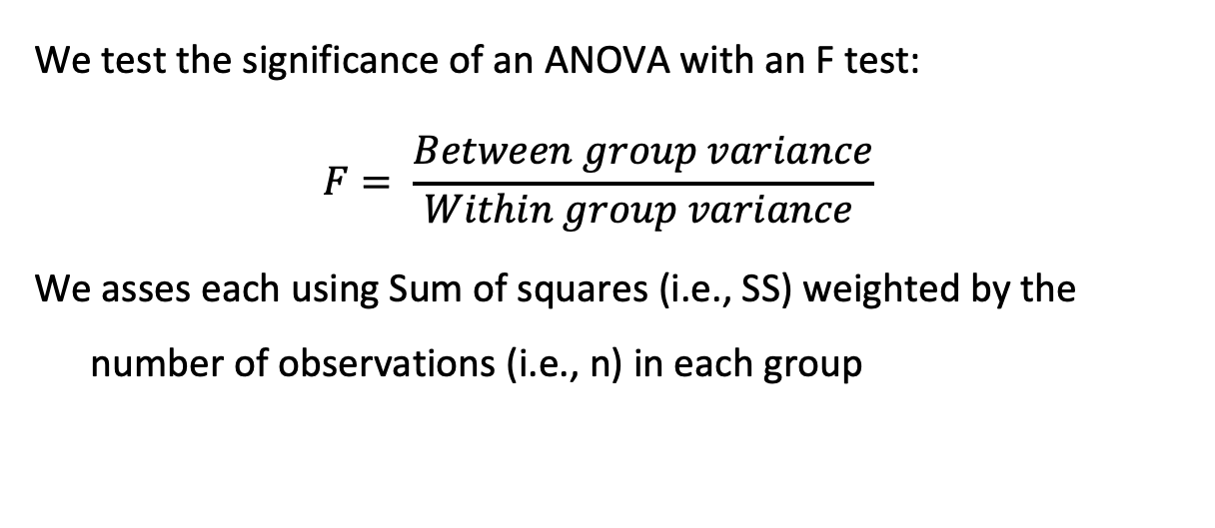
ANOVA
We test the significance of an ANOVA with an F test:
$$F= \frac{Between group variance}{Within group variance }$$
We asses each using Sum of squares (i.e., SS) weighted by the number of observations (i.e., n) in each group

Slide 49
ANOVA
Between-group SS
How spread apart are your group means
Within-group SS
How spread apart is each distribution
*** Note we always normalize these by their degrees of freedom
*** See code for visual depiction of an example with three means

Slide 50
ANOVA
How is a One-way ANOVA different from a t-test:
T-tests are used to test the difference between TWO means whereas ANOVAs test the difference between two or more means

Slide 51
ANOVA
How is a One-way ANOVA different from a t-test:
They both test slightly different questions: t-tests tells you if TWO means are different whereas an ANOVA will tell you if there are mean differences but NOT WHICH means are different

Slide 52
ANOVA
The ANOVA can be generalized to test multiple dependent variables like the Two-way ANOVA
With multiple factors / DV you can test interactions in what we call a ‘crossed’ model where every group A co-occurs with every group B

Slide 53
ANOVA
Factor / DV A
Factor / DV B
Group / Level 1A
Group / Level 2A
Group / Level 3A
Mariah
Halloween
Jlo
Halloween
Lady Gaga
Halloween
Group / Level 1B
Mariah
Christmas
Jlo
Christmas
Lady Gaga
Christmas
Group / Level 2B

Slide 54
ANOVA
Post-hoc testing:
After you are certain that the means differ, what next? Sometimes you need to do additional tests, and sometimes you don’t. This all depends on your underlying question!!!

Slide 55
ANOVA
Post-hoc testing: NOT ALWAYS NECESSARY
In some cases, we just care that the means of our groups are different and not which differ from one another. When we have two groups, we know that they are different, no additional test is needed.

Slide 56
ANCOVA
There are many iterations of an ANOVA including the analysis of covariance!
Here we test the INDEPENDENT effect of dependent variables (factors) regardless of COVARIATES of no interest (referred to as nuisance variables)
*** we will cover this idea in more detail in the regression slides!

Slide 57
Model fitting

Slide 58
What is a model?

Slide 59

What is a model?

Slide 60
What is a model? A way to describee phenomena in abstract terms that is useful for us to understand, define, quantify or predict abstract-- removed from referent

Slide 61
What is a model? “the aim of which is to make a particular part or feature of the world easier to understand, define, quantify, visualize, or simulate “ --Wikipedia

Slide 62
Why use computational models
When studying the brain, we can try to understand how it works at different levels :
Knowing the gist of what a machine is doing/ purpose
Knowing the operations and procedures of the machine
Knowing how the machine implements said procedures

Slide 63
Why use computational models
In the case of a calculator for example:
We know that it adds numbers together
It does so through binary codes, circuits, and wires
It does this by passing electrical current and opening/closing transistors

Slide 64
But how do we fit a model?

Slide 65
Model fitting algorithms
All model fitting algorithms work by trying to find the global minima / maxima of your parameter space
If you think of all possible values of your model parameters plotted against error, fitting a model essentially tries to find the minima in this space

Slide 66
Model fitting algorithms
There are many different algorithms used all with their advantages and disadvantages
One example is Least-squares which tried to minimize the sum of squared residuals (see class XX)
This goes beyond the scope of this class

Slide 67
Model Error
Making predictions comes with some form of error, models are never perfect just like humans aren’t (f.t. Hannah Montana)
But there are many methods to compute how wrong your predictions are from your data

Slide 68
Model Error
It is important to note, however, that when you want to assess how good your model is predicting something you need to use data that your model has not seen (i.e., not been trained on)
This is done to avoid OVERFITTING

Slide 69
Flavours of Error
Error: difference between observed and predicted data
Squared error: square the difference between observed and predicted data
MSE: take the mean of the squared error

Slide 70
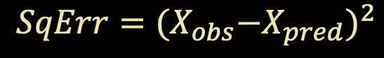

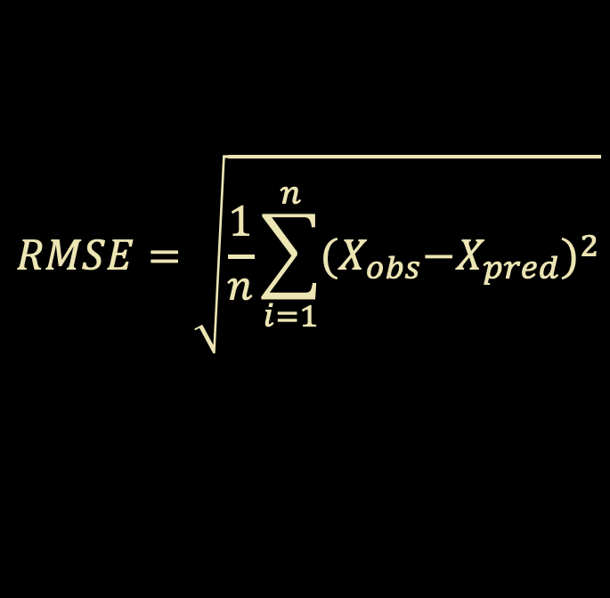
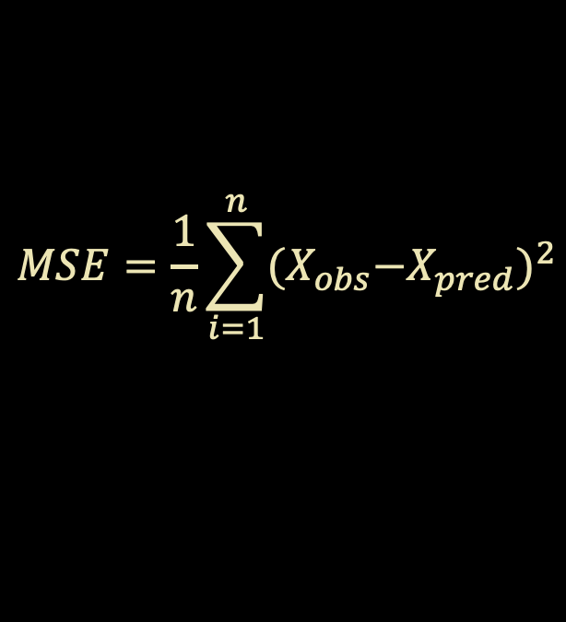
Flavours of Error
$$MSE=\frac{1}{n}\sum_{i=1}^{n}{{{(X}_{obs}−X_{pred})}^{2}}$$
$$Error=X_{obs}−X_{pred}$$
$$RMSE=\sqrt{\frac{1}{n}\sum_{i=1}^{n}{{{(X}_{obs}−X_{pred})}^{2}}}$$
$$SqErr={{(X}_{obs}−X_{pred})}^{2}$$

Slide 71
Picking the best model
The best fitting model is the one that predicts the data the best → this ultimately entails minimizing error (regardless of which kind of error you are measuring)
It is important to note that you want a model that minimizes error within your sample and across all other possible samples (i.e., generalizes)
But there are other considerations beyond minimizing error

Slide 72
Picking the best model
Instead of picking the best model by minimizing error, you can alternatively pick the best model by trying to maximize the likelihood
Said another way, picking a model that maximally produces data like yours

Slide 73
Likelihood functions

Slide 74
Likelihood is NOT probability
In stats probability represents possibilities that are exhaustive and mutually exclusive (e.g. a coin toss), they always add up to 1
Likelihoods do not need to be exhaustive or exclusive

Slide 75
So what is Likelihood
Looking at a probability density function we can understand the differences between probability and likelihood
Probability is the area under the curve up to a value xi
Likelihood is the value of the function at xi

Slide 76
So what is Likelihood

Slide 77
Example…
Let us assume we are a data scientists at Vogue and want to find out which musician is the most likely to have sung the latest hit song

Slide 78
Example…
J Lo
Mariah Carey

Slide 79
Example…
J Lo
Mariah Carey

Slide 80
Example…
J Lo
Mariah Carey

Slide 81
Example…

Slide 82
Likelihood
Therefore, we can see how maximizing the likelihood can generate a model that best explains the distribution of our data based on an unknown parameter (random variable)

Slide 83
Likelihood
The goodness-of-fit of models will be described in Log likelihoods. These values by themselves are meaningless. They can only tell you how well a model fits RELATIVE to another model fit on the SAME data.

Slide 84
Model selection
Each model has a different number of ‘free’ variables / values that can vary
The more your model is free to vary, the better it can fit data
Visually, this is the equivalent of adding more bends to your data
While we love flexibility, models that are too flexible are hard to interpret and tend not to generalize well

Slide 85
Model selection

Slide 86
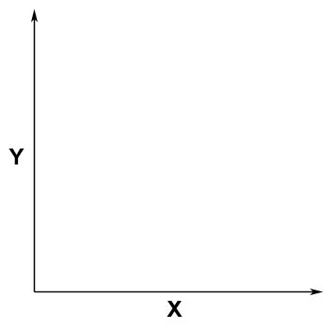
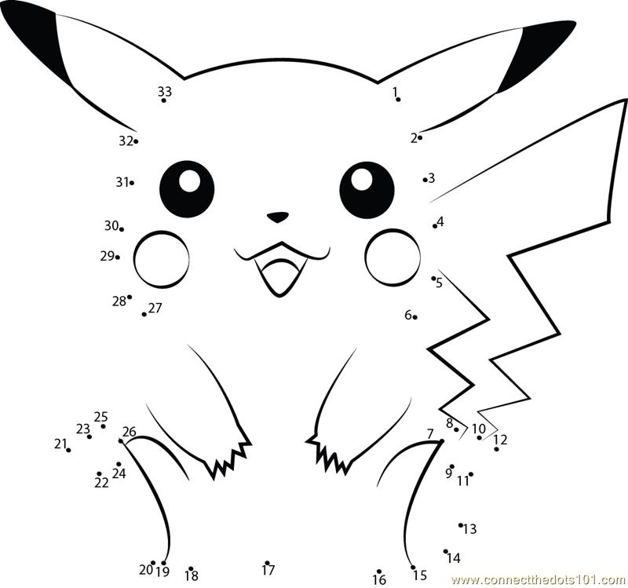
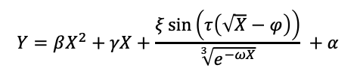
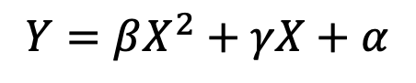
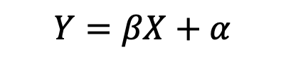
Overfitting
$$Y=βX+α$$
$$Y=βX^{2}+γX+α$$
$$Y=βX^{2}+γX+\frac{ξ\sin\left(τ\left(\sqrt{X}−φ\right)\right)}{\sqrt[3]{e^{−ωX}}} +α$$

Slide 87

Occam’s Razor
“Plurality should not be posited without necessity.”
Heuristic for the development of scientific models
Parsimonious
Falsifiable
Related to Overfitting

Slide 88
Model selection
We can try and quantify a measure that balances both the fit of the model as well as parsimony (i.e., the number of parameters)
Akaike information criterion (AIC).
−2logL(θ) + 2k
Bayesian information criterion (BIC)
−2logL(θ) + k*log(T)
Where k is the number of parameters fit to T observations

Slide 89
Linear regression

Slide 90
What is a regression?

Slide 91
To put it simply a regression is a set of statistical tools used to describe and quantify the relationship between dependent and independent variables

Slide 92
Dependent variables (y) are the outcomes we wish to predict based on independent variables

Slide 93
Independent variables (x) are the covariates/ predictors / features we think change the value of the outcome variable in a quantifiable way

Slide 94
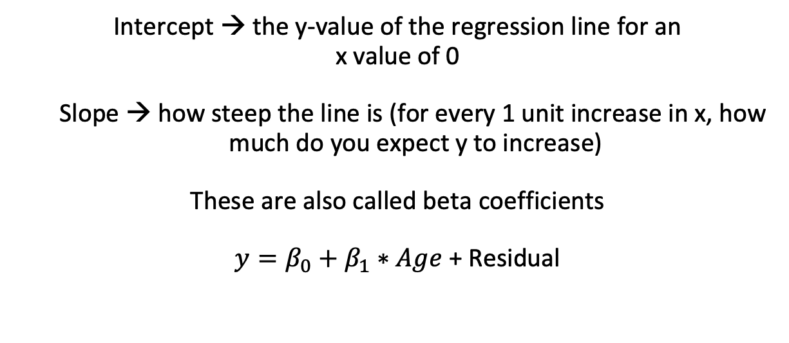
Linear Regression Models
Intercept → the y-value of the regression line for an
x value of 0
Slope → how steep the line is (for every 1 unit increase in x, how much do you expect y to increase)
These are also called beta coefficients
$y=β_{0}+β_{1}∗Age$ + Residual

Slide 95
Linear Regression Models

Slide 96
Statistical twins
ANOVAs and Linear regressions are not so different from one another… they are a LOT alike! In fact ANOVAs are a special case of a regression where all variables are categorical
Let us explore how they are two sides of the same coin:

Slide 97
Statistical twins
If you run a one-way ANOVA and a regression, you will notice that the ‘cell’ means or group means are in fact the same as the coefficients (i.e., effects) of a regression when you consider the intercept. See code for example
*** Note that the way you code your data will affect how you interpret the results! See next class for details.

Slide 98
Advanced regression models

Slide 99
Linear regressions can be a kind of computational model… we can predict values of y from x!

Slide 100
Types of regression models
Linear Model:
Used when the outcome variables are continuous
Logistic Model:
Used when the outcome variables are binary
Hierarchical Model:
Used when your data has a defined structure (i.e., variables are nested)

Slide 101
Linear Regression Models
Coding of your ordinal predictors is important for the interpretation of your betas/ coefficients:
Linear coding: 1 2 3 assumes that there is a linear relationship between the orders (i.e., x=1 is half of x=2, etc.)

Slide 102
Linear Regression Models
Coding of your categorial predictors is very important for the interpretation of your betas:
Dummy coding
Effect Coding

Slide 103
Dummy coding
Attention | Difficulty | Dummy Attention | Dummy Difficulty
High | easy | 1 | 0
Low | easy | 0 | 0
High | easy | 1 | 0
High | hard | 0 | 1
Low | hard | 1 | 1
High | hard | 0 | 1
Attention (X1) | Difficulty (X2) | Var Attention | Var Difficulty
High | easy | 1 | 0
Low | easy | 0 | 0
High | easy | 1 | 0
High | hard | 0 | 1
Low | hard | 1 | 1
High | hard | 0 | 1
Let’s say we have two categorical variables:
Attention (high vs low)
Difficulty (easy vs hard)
Dummy code them as 0 and 1

Slide 104
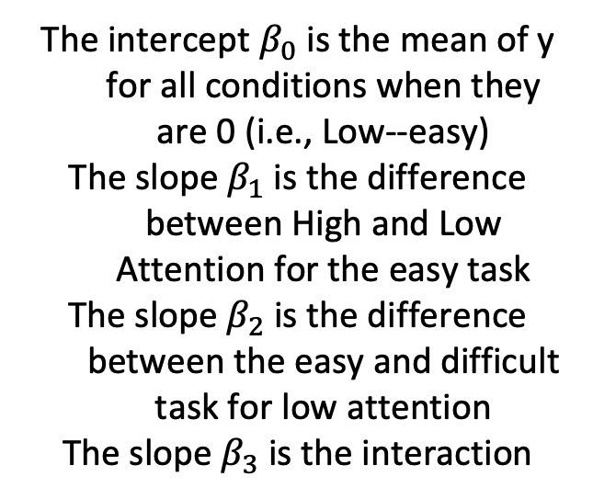
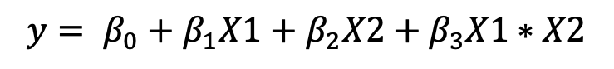
Dummy coding
Attention | Difficulty | Dummy Attention | Dummy Difficulty
High | easy | 1 | 0
Low | easy | 0 | 0
High | easy | 1 | 0
High | hard | 0 | 1
Low | hard | 1 | 1
High | hard | 0 | 1
Attention (X1) | Difficulty (X2) | Var Attention | Var Difficulty
High | easy | 1 | 0
Low | easy | 0 | 0
High | easy | 1 | 0
High | hard | 0 | 1
Low | hard | 1 | 1
High | hard | 0 | 1
The intercept $β_{0}$ is the mean of y for all conditions when they are 0 (i.e., Low--easy)
The slope $β_{1}$ is the difference between High and Low Attention for the easy task
The slope $β_{2}$ is the difference between the easy and difficult task for low attention
The slope $β_{3}$ is the interaction
$$y= β_{0}+β_{1}X1+β_{2}X2+β_{3}X1∗X2$$

Slide 105




Dummy coding
Our regression model: $y= β_{0}+β_{1}X1+β_{2}X2+β_{3}X1∗X2$
$$y= β_{0}+β_{1}0+β_{2}0+β_{3}0∗0$$
$$y= β_{0}$$
$$y= β_{0}+β_{1}1+β_{2}0+β_{3}1∗0$$
$y= β_{0}$ $+β_{1}$
$$y= β_{0}+β_{1}0+β_{2}1+β_{3}0∗1$$
$y= β_{0}$ $+β_{2}$
$$y= β_{0}+β_{1}1+β_{2}1+β_{3}1∗1$$
$y= β_{0}$ $+β_{1}+β_{2}+β_{3}$

Slide 106

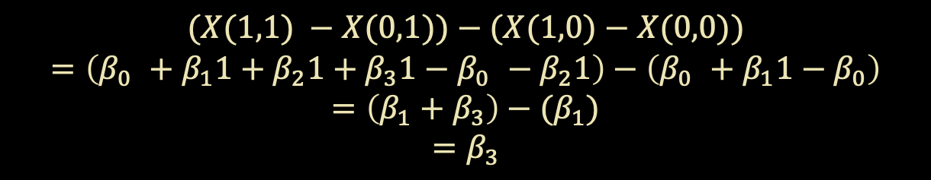

Dummy coding
Our regression model: $y= β_{0}+β_{1}X1+β_{2}X2+β_{3}X1∗X2$
$X\left(1,0\right)− X\left(0,0\right)= β_{0}+β_{1}1−$ $β_{0}$
$$X\left(1,0\right)− X\left(0,0\right) = β_{1}$$
$X\left(0,1\right)− X\left(0,0\right)= β_{0}+β_{2}1−$ $β_{0}$
$$X\left(0,1\right)− X\left(0,0\right) = β_{2}$$
$$(X(1,1) −X(0,1))−(X(1,0)−X(0,0))$$
$$=\left(β_{0} +β_{1}1+β_{2}1+β_{3}1−β_{0} −β_{2}1\right)−\left(β_{0} +β_{1}1−β_{0}\right)$$
$$=\left(β_{1}+β_{3}\right)−(β_{1})$$
$$=β_{3}$$

Slide 107
Effect coding
Attention | Difficulty | Dummy Attention | Dummy Difficulty
High | easy | 1 | 0
Low | easy | 0 | 0
High | easy | 1 | 0
High | hard | 0 | 1
Low | hard | 1 | 1
High | hard | 0 | 1
Attention (X1) | Difficulty (X2) | Var Attention | Var Difficulty
High | easy | 1 | -1
Low | easy | -1 | -1
High | easy | 1 | -1
High | hard | 1 | 1
Low | hard | -1 | 1
High | hard | 1 | 1
In effect coding all columns of variables sum to 0
To do this let’s try replacing the 0’s with -1

Slide 108
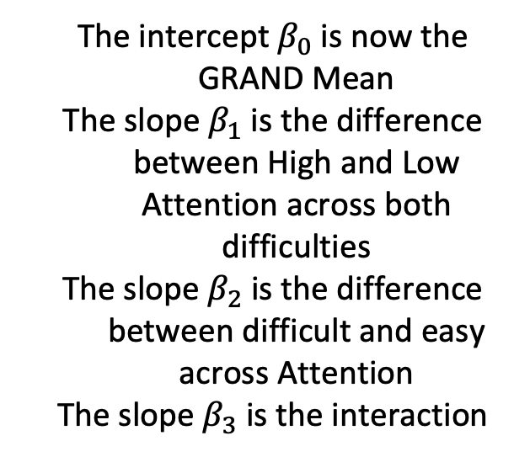
Effect coding
Attention | Difficulty | Dummy Attention | Dummy Difficulty
High | easy | 1 | 0
Low | easy | 0 | 0
High | easy | 1 | 0
High | hard | 0 | 1
Low | hard | 1 | 1
High | hard | 0 | 1
Attention (X1) | Difficulty (X2) | Var Attention | Var Difficulty
High | easy | 1 | -1
Low | easy | -1 | -1
High | easy | 1 | -1
High | hard | 1 | 1
Low | hard | -1 | 1
High | hard | 1 | 1
The intercept $β_{0}$ is now the GRAND Mean
The slope $β_{1}$ is the difference between High and Low Attention across both difficulties
The slope $β_{2}$ is the difference between difficult and easy across Attention
The slope $β_{3}$ is the interaction
$$y= β_{0}+β_{1}X1+β_{2}X2+β_{3}X1∗X2$$

Slide 109




Effect coding
Our regression model: $y= β_{0}+β_{1}X1+β_{2}X2+β_{3}X1∗X2$
$$y= β_{0}+β_{1}(−1)+β_{2}(−1)+β_{3}(−1)∗(−1)$$
$$y= β_{0}−β_{1}−β_{2}+β_{3}$$
$$y= β_{0}+β_{1}(1)+β_{2}(−1)+β_{3}(1)∗(−1)$$
$$y= β_{0}+β_{1}−β_{2}−β_{3}$$
$$y= β_{0}+β_{1}(−1)+β_{2}(1)+β_{3}(−1)∗(−1)$$
$$y= β_{0}−β_{1}+β_{2}−β_{3}$$
$$y= β_{0}+β_{1}(1)+β_{2}(1)+β_{3}(1)∗(1)$$
$$y= β_{0}+β_{1}+β_{2}+β_{3}$$

Slide 110
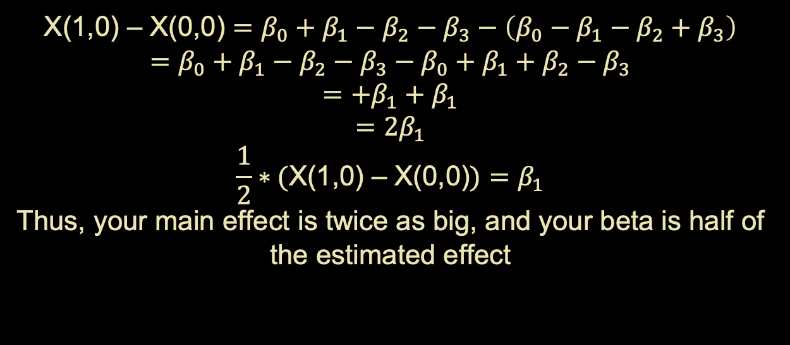
Effect coding
Our regression model: $y= β_{0}+β_{1}X1+β_{2}X2+β_{3}X1∗X2$
X(1,0) – X(0,0) $=β_{0}+β_{1}−β_{2}−β_{3}−\left(β_{0}−β_{1}−β_{2}+β_{3}\right)$
$$=β_{0}+β_{1}−β_{2}−β_{3}−β_{0}+β_{1}+β_{2}−β_{3}$$
$$=+β_{1}+β_{1}$$
$$=2β_{1}$$
$$\frac{1}{2}∗(\text{X}\text{(1,0) – }\text{X}\text{(0,0)})=β_{1}$$
Thus, your main effect is twice as big, and your beta is half of the estimated effect

Slide 111
Effect coding
Attention (X1) | Difficulty (X2) | Var Attention | Var Difficulty
High | easy | 0.5 | -0.5
Low | easy | -0.5 | -0.5
High | easy | 0.5 | -0.5
High | hard | 0.5 | 0.5
Low | hard | -0.5 | 0.5
High | hard | 0.5 | 0.5
What about replacing 0’s with -0.5 and 1’s with 0.5

Slide 112
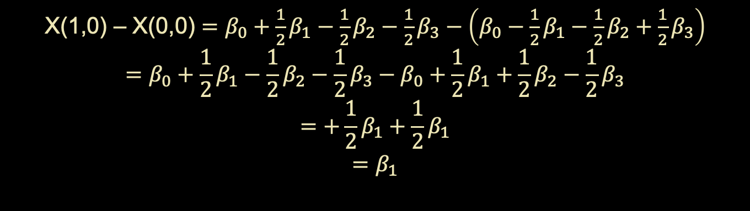
Effect coding
Our regression model: $y= β_{0}+β_{1}X1+β_{2}X2+β_{3}X1∗X2$
X(1,0) – X(0,0) $=β_{0}+{\frac{1}{2}β}_{1}−{\frac{1}{2}β}_{2}−\frac{1}{2}β_{3}−\left(β_{0}−{\frac{1}{2}β}_{1}−{\frac{1}{2}β}_{2}+\frac{1}{2}β_{3}\right)$
$$=β_{0}+{\frac{1}{2}β}_{1}−{\frac{1}{2}β}_{2}−{\frac{1}{2}β}_{3}−β_{0}+{\frac{1}{2}β}_{1}+\frac{1}{2}β_{2}−{\frac{1}{2}β}_{3}$$
$$=+\frac{1}{2}β_{1}+{\frac{1}{2}β}_{1}$$
$$=β_{1}$$

Slide 113
Linear Regression Models

Slide 114
Linear Regression Models
Regressions can be used in different fashions: testing statistical relationships, predicting future data, removing effects from your data
After fitting regressions, you can compute and utilizes the residuals (i.e., the unexplained variance or y) for further analysis… we want the residuals of a regression to be normal

Slide 115
Linear Regression Models
Because of how linear regressions compute effects (holding all other effects at zero), you can add nuisance variables into your regression to compute your desired effect while controlling for the effect of another uninteresting variable
Alpha power $= β_{0}+β_{1}Age+β_{2}Attenion+β_{3} Sleep Quality$

Slide 116
Linear Regression Models
Because of how linear regressions compute effects (holding all other effects at zero), you can add nuisance variables into your regression to compute your desired effect while controlling for the effect of another uninteresting variable
Alpha power $= β_{0}+β_{1}Age+β_{2}Attenion+β_{3} Sleep Quality$
controlling for age effects / confounds

Slide 117
Multicollinearity
A problem when two or more of your predictors / regressors/ measures are related to one another (i.e., correlated)
For example, participant height and weight
One assumption of regressions are that the measures are independent, and if this violated the beta coefficients estimated become unstable and sensitive to small changes

Slide 118
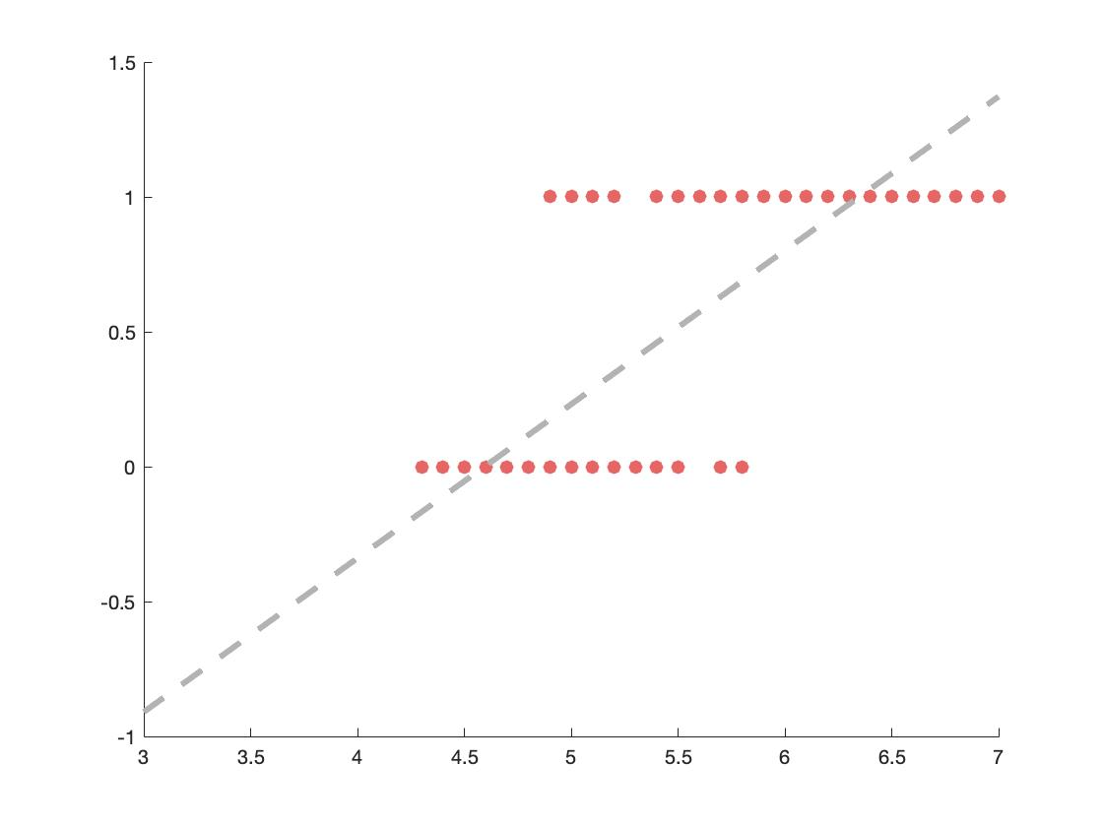
Logistic Regression
Linear regression work very well on continuous outcomes, but what happens when your outcome is categorical or binary? Fitting a line just doesn’t cut it

Slide 119
Logistic Regression
But if we fit a different function to the data, it might fit it much better…
Here comes in Logistic Functions

Slide 120
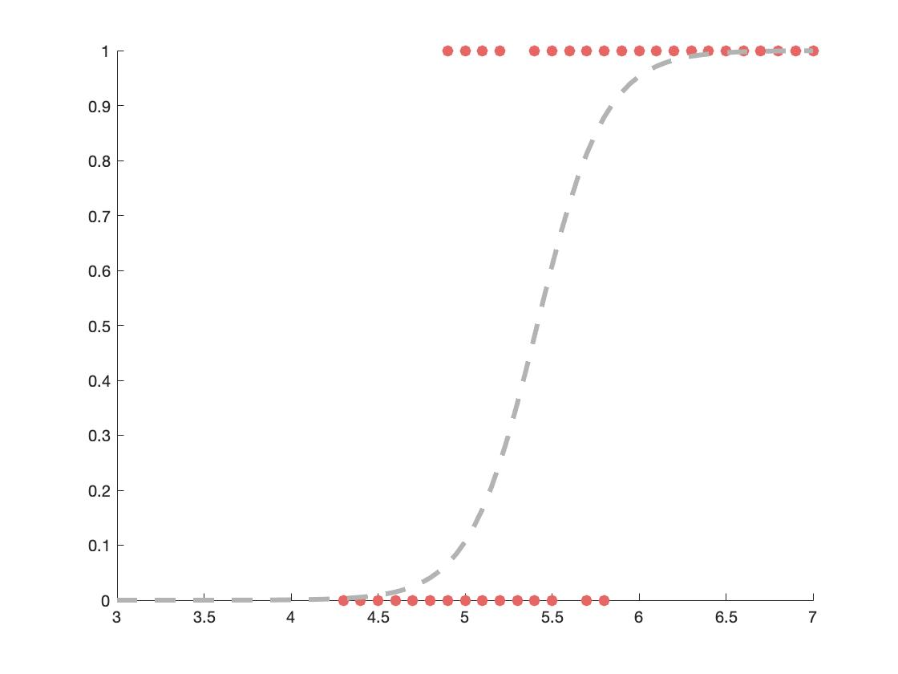
Logistic Regression
But if we fit a different function to the data, it might fit it much better…
Here comes in Logistic Functions

Slide 121
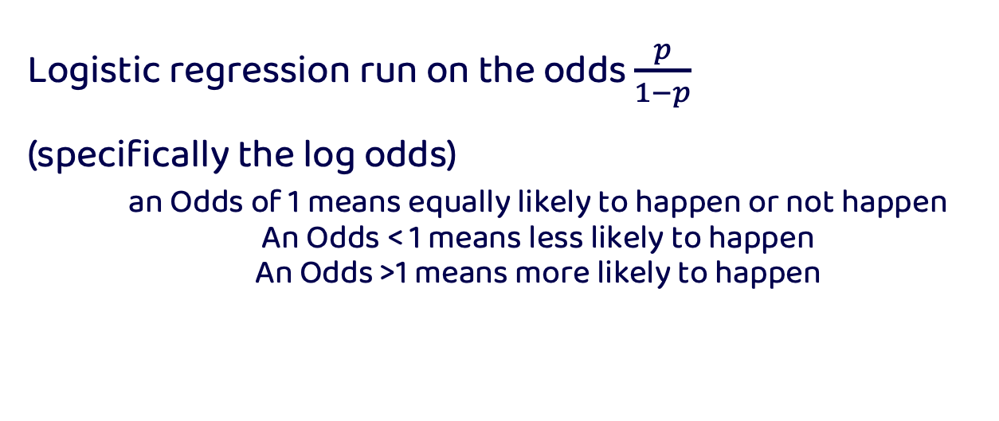
Logistic Regression
Logistic regression run on the odds $\frac{p}{1−p}$
(specifically the log odds)
an Odds of 1 means equally likely to happen or not happen
An Odds < 1 means less likely to happen
An Odds >1 means more likely to happen

Slide 122
Odds
Probability
0 0.5 1
p/(1-p)
Odds
0 1 Inf
ln(x)
Log Odds
-Inf 0 Inf

Slide 123
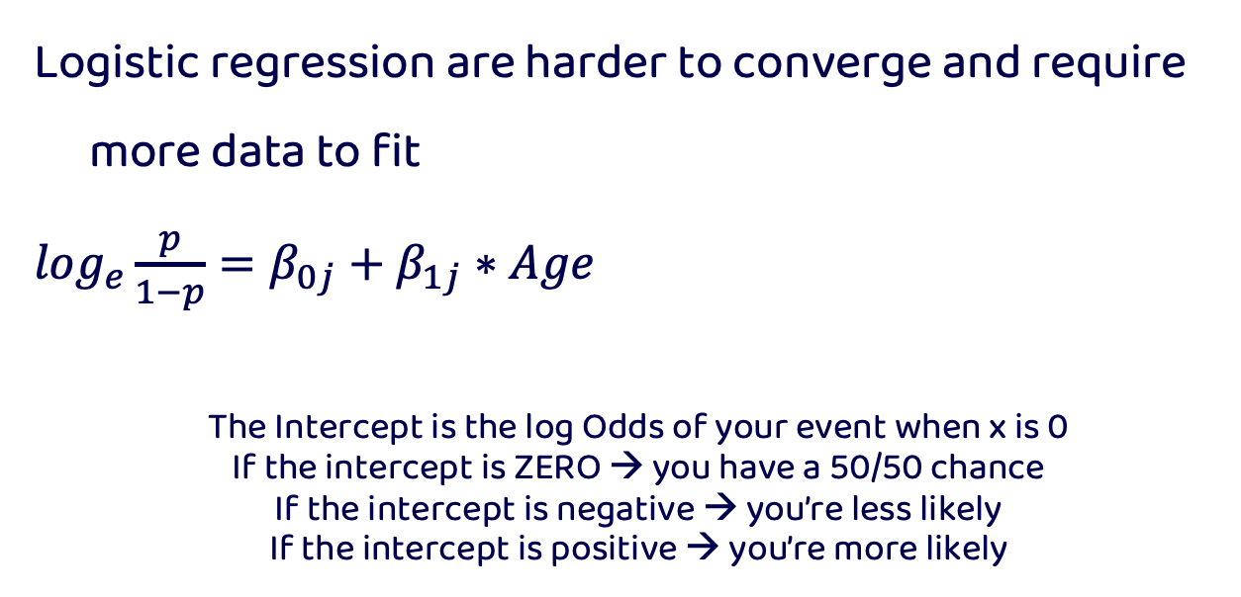
Logistic Regression
Logistic regression are harder to converge and require more data to fit
$\log_{e}\frac{p}{1−p}=β_{0j}+β_{1j}∗Age$
The Intercept is the log Odds of your event when x is 0
If the intercept is ZERO → you have a 50/50 chance
If the intercept is negative → you’re less likely
If the intercept is positive → you’re more likely

Slide 124
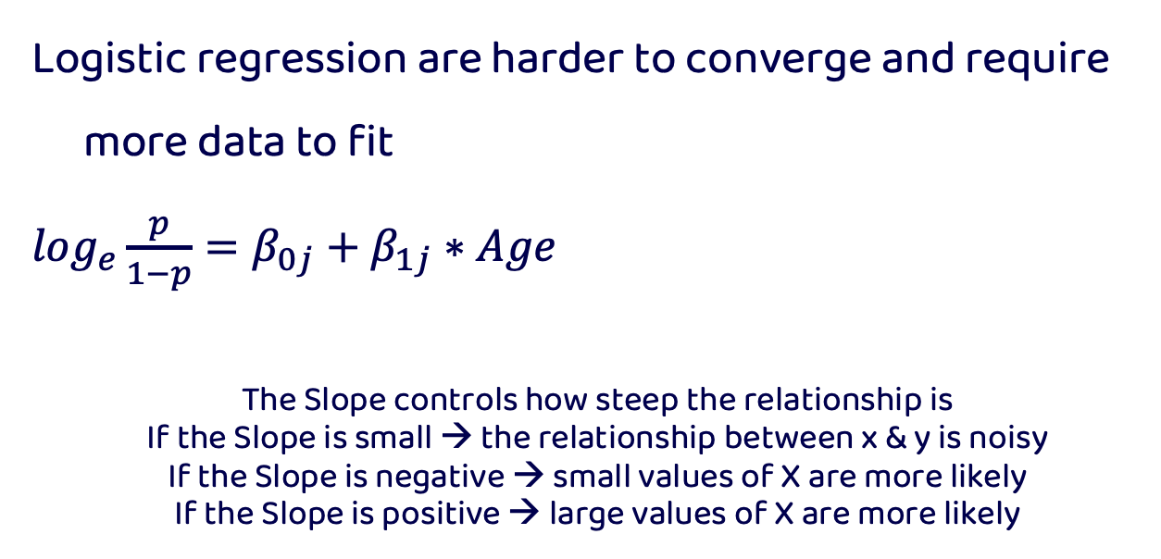
Logistic Regression
Logistic regression are harder to converge and require more data to fit
$\log_{e}\frac{p}{1−p}=β_{0j}+β_{1j}∗Age$
The Slope controls how steep the relationship is
If the Slope is small → the relationship between x & y is noisy
If the Slope is negative → small values of X are more likely
If the Slope is positive → large values of X are more likely

Slide 125


Nested data
What is the best song to dance to?

Slide 126






Nested data
What is the best song to dance to?

Slide 127
Nested data
What is the best song to dance to?
Le Club
Muzique
Le Rouge
GAY
Club MED
Studio 54

Slide 128
Nested data
What is the best song to dance to?
Canada
UK
USA
Le Club
Muzique
Le Rouge
GAY
Club MED
Studio 54

Slide 129
Nested data
Observations within the same country, for example, are more similar to themselves than to a different country
When data is nested, it is important that your model takes into account the correlational structure of your data

Slide 130
Nested data
Regressions assume that all your predictors (i.e., measures) are independent. But this may not always be the case, specifically for repeated measure designs where participants see multiple experimental conditions

Slide 131
Nested data
The independence of each observation is often violated in real life—data is nested in a big wonderful world
People are more similar to themselves, their family, their friends, people from their city, country etc

Slide 132
Nested data
Regression models need to consider the correlated structure of your observations to better deal with noise
Adding this info to your regression will allow you to better predict out of sample

Slide 133
Hierarchical regressions
Hierarchical regressions allow you to take into account the structure of your data to help better estimate your effects and deal with noise that can be accounted for by your nested data

Slide 134
Hierarchical regressions
This is achieved by allowing Intercepts or slopes to vary as a function of the levels/ nests within your data
For example, allowing every person in your sample to get a different intercept accounts for the fact that people have differences in response times, but fixing the slope of the regression lets you test the effect across your conditions

Slide 135
Hierarchical regressions
Fitting a line to our data sometimes does not capture the complicated effect we may have

Slide 136
Hierarchical regressions
Random Intercept
Sometime our effect is constant across individuals, but they may vary in their baseline ability

Slide 137
Hierarchical regressions
Random Slope
Sometime our effect changes across groups too

Slide 138
Hierarchical regressions
See http://mfviz.com/hierarchical-models/ for interactive example demonstrating fixed vs random slopes and intercepts

Slide 139
Fixed vs Random effects
Note that hierarchical models have both fixed and random effects
Fixed effects—assume you have every desired level of variable (e.g., experimental condition)
Random effects—assume you do not have every possible level you wish to test (e.g., participant)

Slide 140
Fixed vs Random effects
Fixed effects—sometimes are also referred to as variables you MANIPULATE
Random effects—sometimes referred to as variables that are sources of variation in your data that you do not care about

Slide 141
THANKS!

Slide 142
Retro icon pack

Slide 143
Computer icon pack

